Slide 1

Village of Trumansburg
Comprehensive Plan Update
Public Information Meeting
July 26, 2021

Slide 2
Agenda
7:00-7:45: Presentation
Opening Remarks
Revision Process To Date
Draft Plan Highlights
Tentative Adoption Timeline
7:45-9:00: Q&A
We want to hear from you!

Slide 3
Opening Remarks
Mayor Rordan Hart

Slide 4
Why Update the Comprehensive Plan?
Assess current conditions
+
Revisit and revise the community-wide vision
+
Develop new action steps for achieving that vision

Slide 5

Benefits of an Updated Comprehensive Plan
Leverage funding
Improve chances for grants & loans
Demonstrate “Project Readiness”
Funding Sources
Federal & NYS grant programs
Gifts
Corporations
Not-for-Profits
Tax revenues
Bonding

Slide 6
What should the Comprehensive Plan address?
It should address challenges and opportunities for orderly growth, providing continued guidance for decision-making
It should provide a sound basis for village-wide policies for:
  Sustainable economic growth and development
  Preservation of important resources such as public open space
  Identification of community needs and capital improvements
  Creation or revision of local land use laws

Slide 7
Revision Process To Date

Slide 8
Overview
3 Years of Dedicated Work
10 Committee Members
22 Open Committee Meetings
66 Public Info Meeting Participants
266 Survey Respondents
Ben Darfler, Chair (Village Trustee)
Steph Bailey (Planning Board Alt)
David Breeden (Community)
Noah Demarest (Zoning Board)
Jessica Giles (Planning Board)
Rachel Giordano (Community)
Jack Katz (Community)
Kathy Klemperer (Community)
Tom Myers (Code & Zoning Officer)
Thomas Pepe (Community)
Scott Sheavly (Zoning Board)

Slide 9
Review of the ‘08 Plan (2018-19)
2018 Fall
Committee Formed
Issued RFP for planning services
2019 Winter/Spring
Awarded bid to Environmental Design & Research (EDR)
Reviewed ‘08 Outline & Vision
Drafted ‘21 Outline & Vision
Identified Village “Character Areas”
2019 Summer/Fall
Reviewed ‘08 Goals & Strategies
Held Public Info Meeting
  Feedback on the draft ‘21 outline and vision
  Gathered key opportunities and challenges from the attendees

Slide 10
Creation of the Draft ‘21 Plan (2020-21)
2020 Winter/Spring
Stakeholder meetings with village boards and department heads
Reviewed Draft Ch 1 & 2 from EDR
Pivoted from second public meeting to community survey due to COVID
Reviewed ‘08 Survey
Created ‘21 Survey
Drafted ‘21 Goals
2020 Summer/Fall
Publicized and Promoted Survey
Analyzed Survey Responses
Drafted ‘21 Strategies & Actions
Reviewed Draft Ch 3 & 4 from EDR
Submitted Draft to Village Board
2021 Winter/Spring
Village Board Review of Draft
Submitted Draft to Community

Slide 11
Draft Plan Highlights

Slide 12
2008 20-Year Vision
WORKING TOGETHER, WE ENVISION TRUMANSBURG TWENTY YEARS FROM NOW AS A PLACE WHERE:
The community values safety, economic and cultural diversity and local cultural history in concert with an accessible and attractive commercial center that supports the needs of residents and visitors to the Village.
Housing is offered in a mix of architectural styles and a range of affordable options. The street and sidewalk networks will provide an opportunity for various transportation options within the Village. Neighborhoods will be well connected to the commercial core of the community.
The downtown core is a thriving mix of businesses which meet the daily needs of residents from the Village and surrounding rural communities. The downtown core remains the hub for economic development, supporting a diverse selection of businesses.
Green space throughout the Village is preserved and maintained to provide residents with the opportunity to connect with nature. Environmentally sound initiatives are put in place to provide future generations with a healthy, sustainable community.
Through the cooperative planning efforts of residents and business owners, the Village, is a self-sustaining, creative and friendly community with established zoning regulations that provide sufficient infrastructure and enable small businesses to thrive while embracing the rural character of the Village.

Slide 13
20-Year Vision
2008 Themes
2021 Draft Themes
Diversity
Local History
Housing Diversity and Affordability
Village Character
Business & Economic Development
Environmental Sustainability
Balances growth and character
Safety
Diversity
Local History
Housing Diversity and Affordability
Village Character
Business & Economic Development
Environmental Sustainability
Balances growth and character
Public Health & Safety
Education
Transparent and Responsive Local Government
Fiscally Responsible Government

Slide 14
2021 Draft 20-Year Vision
Trumansburg, NY, in the heart of the Finger Lakes, is a safe, friendly, and energetic community that values its rich history, picturesque natural settings, attractive neighborhoods, surrounding rural areas, and local businesses.
We as a community envision a future Village that:
Offers ample, diverse, and inclusive opportunities for employment, education, and housing;
Encourages social interaction and community engagement in all aspects of Village life by people of all age groups, income levels, and cultural backgrounds;
Protects and promotes our small-town atmosphere with distinctive neighborhoods, downtown businesses and institutions;
Supports entrepreneurs and local businesses that provide services to residents and visitors;
Advances environmental and economic sustainability by encouraging moderate population growth while protecting open space and natural resources;
Is guided by a transparent, responsive, and fiscally responsible Village government committed to public service, health, safety, and welfare.

Slide 15
Contents
2008 Comprehensive Plan
2021 Draft Comprehensive Plan
Introduction
Village Elements
  Community
  Housing
  Economic Development
  Environment
  Recreation
  Land Use
Strategies
  Mirrors the 6 sections above
Introduction
Community Profile
  Demographics & Socioeconomics
  Character Areas
Trumansburg Today and Moving Forward
  Natural Resources
  Historic & Cultural Resources
  Housing
  Government & Educational Institutions
  Parks & Recreation
  Land Use & Development
  Public Health, Safety & Emergency Services
  Transportation
  Infrastructure & Utilities
  Climate Change
Goals, Strategies, Actions & Implementations
  Mirrors the 10 sections above

Slide 16
Goals, Strategies & Actions
2008 Comprehensive Plan
2021 Draft Comprehensive Plan
29 Goals, 93 Strategies / Actions
Good ideas but could be more actionable
Mix of Strategies and Actions without direct links to higher level goals Goals
Area: Economic Development Focus
Goal: Not clear
Item: Create a program that would encourage Main Street outlets for locally produced goods
25 Goals, 54 Strategies, 164 Actions
Focused on clarity and actionability
Actions directly linked to Goals and Strategies
Goal: Improve stormwater management and drainage
Strategy: Regulate stormwater runoff quantity and quality
Action: Establish a Stormwater Management Plan for the Village consistent with the New York State Stormwater Management Design Manual

Slide 17
Tentative Adoption Timeline

Slide 18
Tentative Adoption Timeline
July
Begin SEQR Review
First Public Info Meeting
Send to Planning Board for Review
Send to State and County Agencies for Review
August
Continue SEQR Review
Second Public Info Meeting
September
Public Hearing
SEQR Determination
October
Vote on Adoption
Details will be announced on the Village website http://trumansburg-ny.gov

Slide 19
Questions and Feedback
Documents available at http://tinyurl.com/TburgCompPlan
Email feedback to PublicComment@trumansburg-ny.gov

Slide 20
Appendix

Slide 21
2008 Goals
Maintain a safe community that is welcoming to people of all cultures, ages and walks of life.
Maintain a quiet, rural village with an accessible, attractive and historic downtown.
Establish welcoming entrances and continue to encourage well-maintained walkways and tree-lined streets throughout the Village.
Maintain and promote the cultural history of the Village through a variety of partnerships.
Provide excellent education opportunities through the Trumansburg School District that prepare students for jobs, higher education and community engagement.
Maintain a variety of architectural styles, housing densities and housing options that meet the needs of a variety of socio-economic situations.
Establish streets and sidewalks that provide a safe connection between downtown and adjacent residential neighborhoods.
Promote new housing construction that is in harmony with existing neighborhoods, provides off-street parking and sidewalks and allows for efficient installation of infrastructure, roads and green space.
Encourage safe and accessible housing on the upper floors of downtown commercial buildings.
Establish additional affordable housing for seniors in close proximity to downtown amenities.
Create a thriving downtown with a multitude of diverse businesses that meet the daily needs of residents from the Village and surrounding areas.
Support the establishment of numerous home-based micro-enterprises that provide diverse employment opportunities for Village residents.
Maintain and establish commercial buildings that reflect the rural and historic character of the Village.
Enhance cultural resources, education opportunities, historic amenities and marketing strategies that attract businesses and their employees.
Collaborate with the Town of Ulysses to support local agriculture and promote the Trumansburg Farmers Market.
Establish tourist amenities that promote and protect the historic character of Trumansburg.
Accommodate an increasing number of visitors while maintaining a rural, peaceful atmosphere.
Create and maintain open space to balance land preservation and public use.
Collaborate with the Town of Ulysses to protect water quality and promote conservation and appreciation of unique natural assets within the area.
Promote village-wide resource conservation.
Pursue alternative renewable sources of energy.
Create a trail or pedestrian way that connects the Village of Trumansburg to the Black Diamond Trail.
Establish indoor and outdoor recreational facilities that provide activities such as swimming, skateboarding, basketball and tennis.
Establish a multi-purpose community center.
Work in cooperation with Trumansburg School to provide a network of recreational amenities and programs for all ages.
Protect agriculture land, wetlands and green-space that provides contiguous physical and visual connections to the surrounding rural landscape without imposing economic hardships on landowners.
Promote new construction along Main Street with setbacks that are consistent with existing historic buildings and ample parking located preferably behind the structure.
Continue to develop residential neighborhoods of varying densities that offer a range of affordable housing options.
Promote a variety of economic development that serves the needs of the Village residents.

Slide 22
2021 Draft Goals
Protect and Conserve Sensitive Natural Environments
Support Cultural Resources and Volunteer Activities
Preserve Historic Buildings and Community Character without Placing Undue Burden on Property Owners or limits on residential growth
Provide for more affordable rental housing
Provide for more affordable for sale housing
Preserve “small-town” atmosphere
Regulate short term rentals & BnB’s equally and fairly
Promote accessibility in all buildings
Reduce per household tax burden
Improve government transparency and accessibility
Increase School-age population
Increase Coordination between Village and Trumansburg central school district
Improve the health and sustainability of our urban forest
Enhance recreation opportunities
Develop more parks, trails, and open space
Maintain and enhance the beauty of the Village
Promote Land Use compatibility that respects the quality of life in Trumansburg
Promote business development that respects the quality of life in Trumansburg
Promote health and safety through investment in facilities and services
Improve pedestrian and bicycle safety and accessibility along the Main Street Corridor and throughout the community
Improve parking options on Main Street
Reduce traffic speed and traffic noise in the Village
Improve stormwater management and drainage
Ensure that water supply and sanitary sewer service can support future growth
Transition to net zero greenhouse gas emissions by 2040

Slide 23
2021 Priority Actions

Slide 24
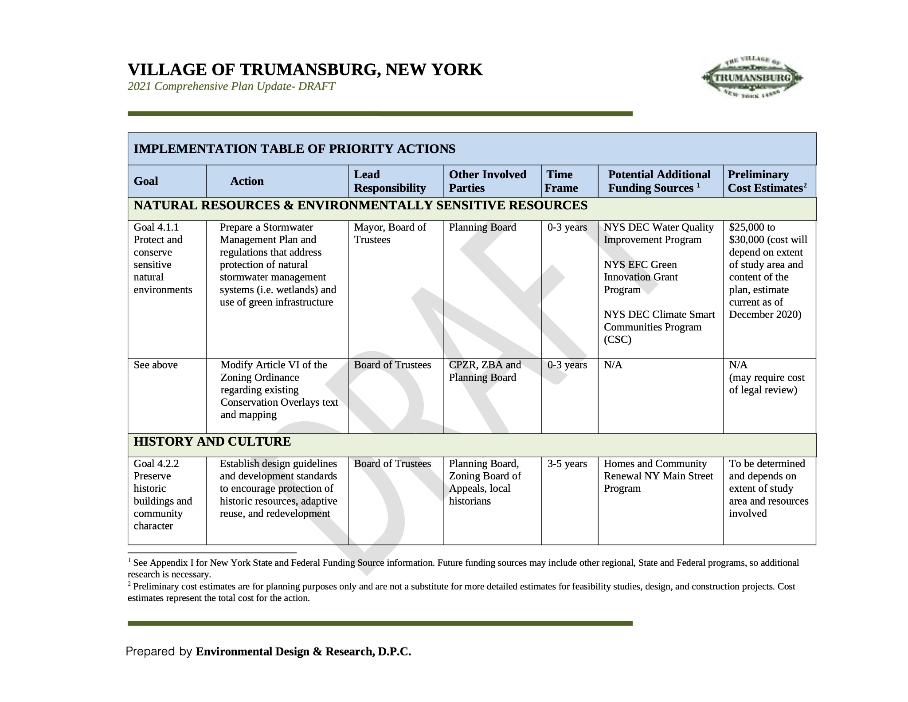

Slide 25
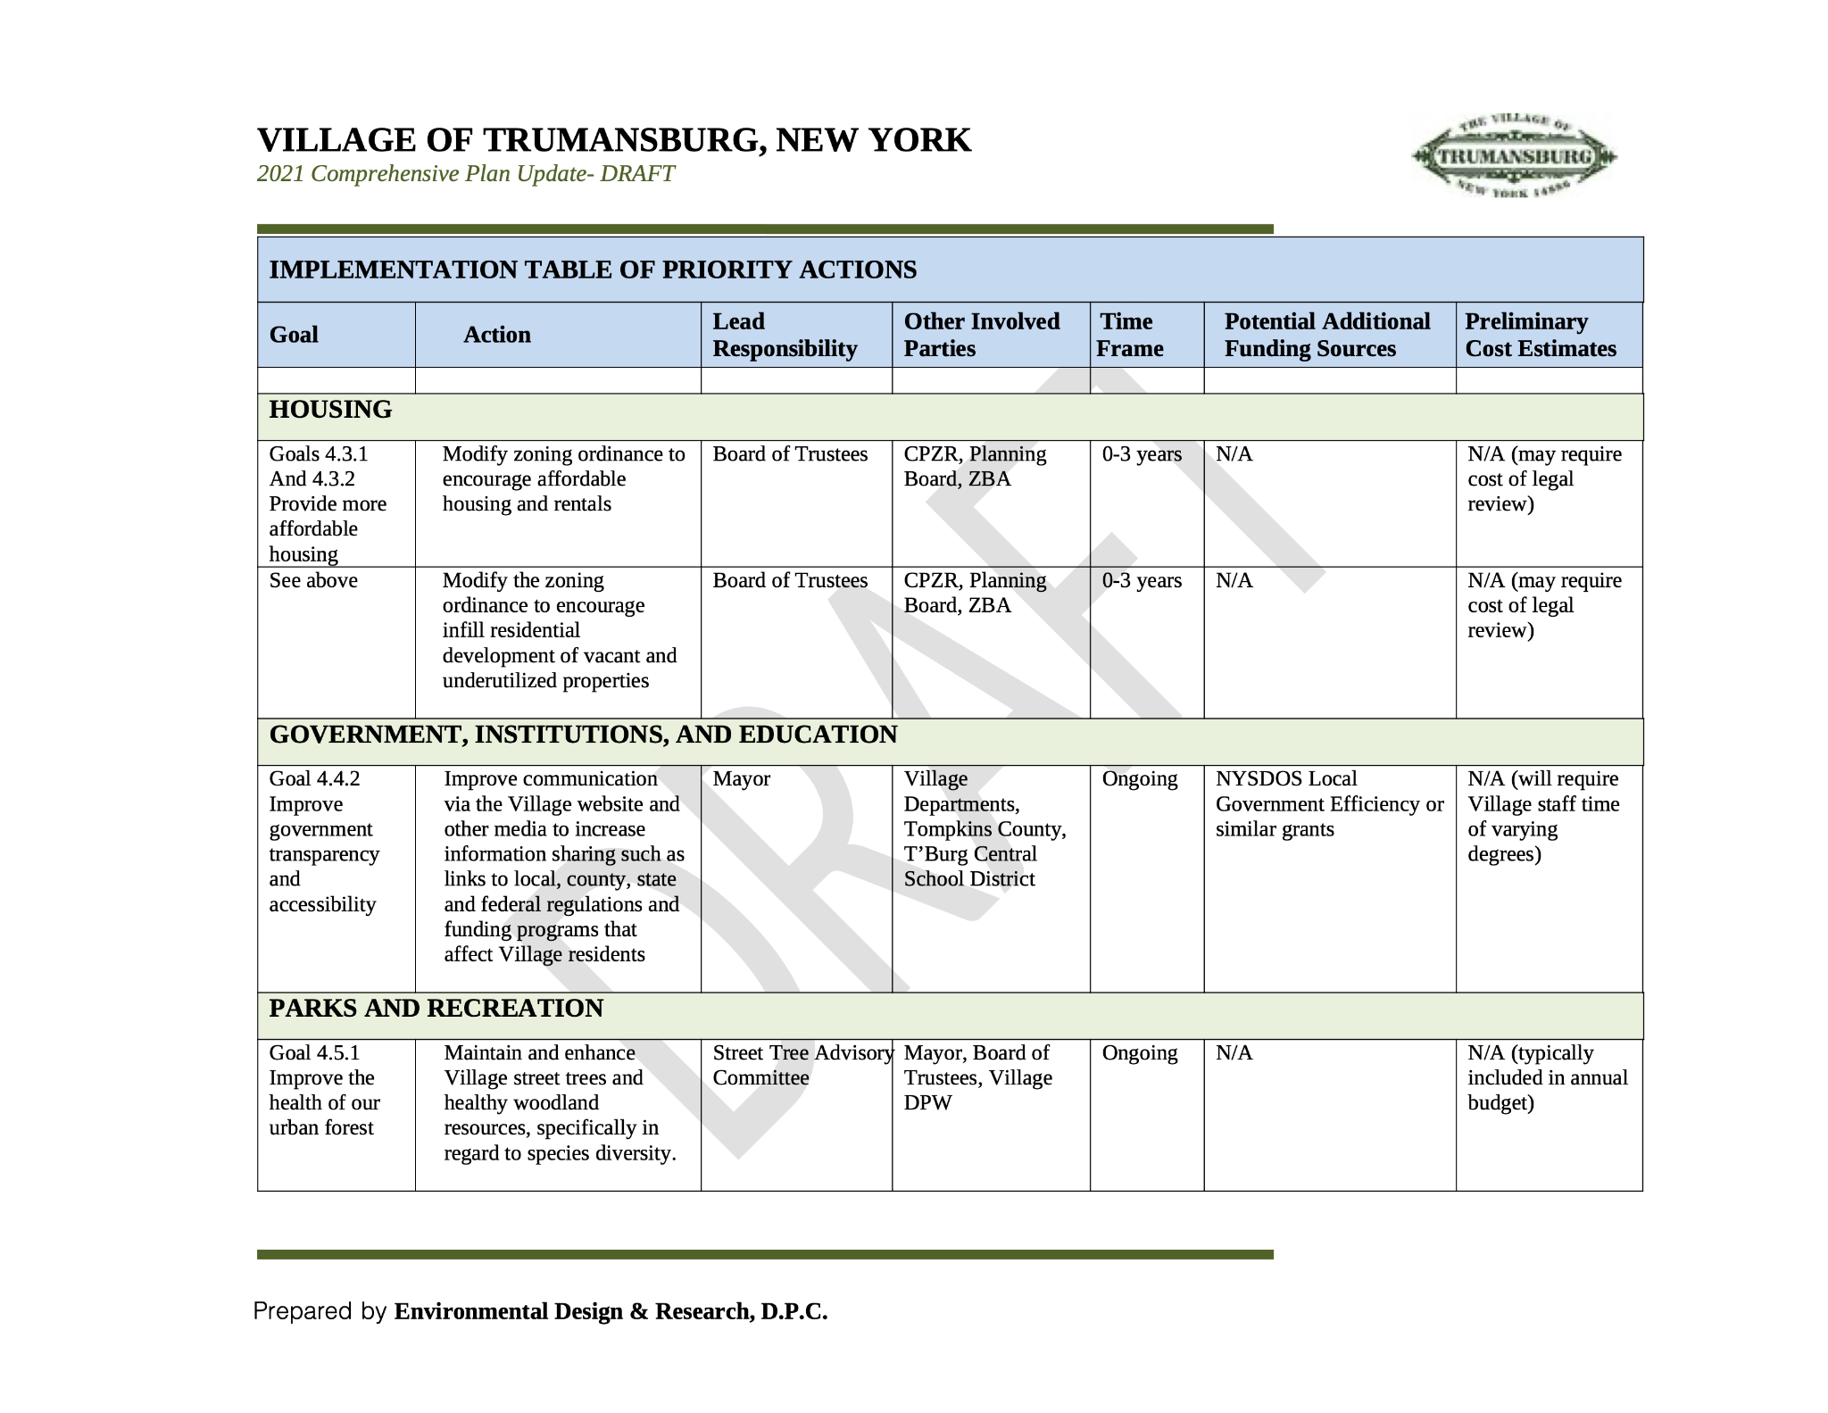

Slide 26
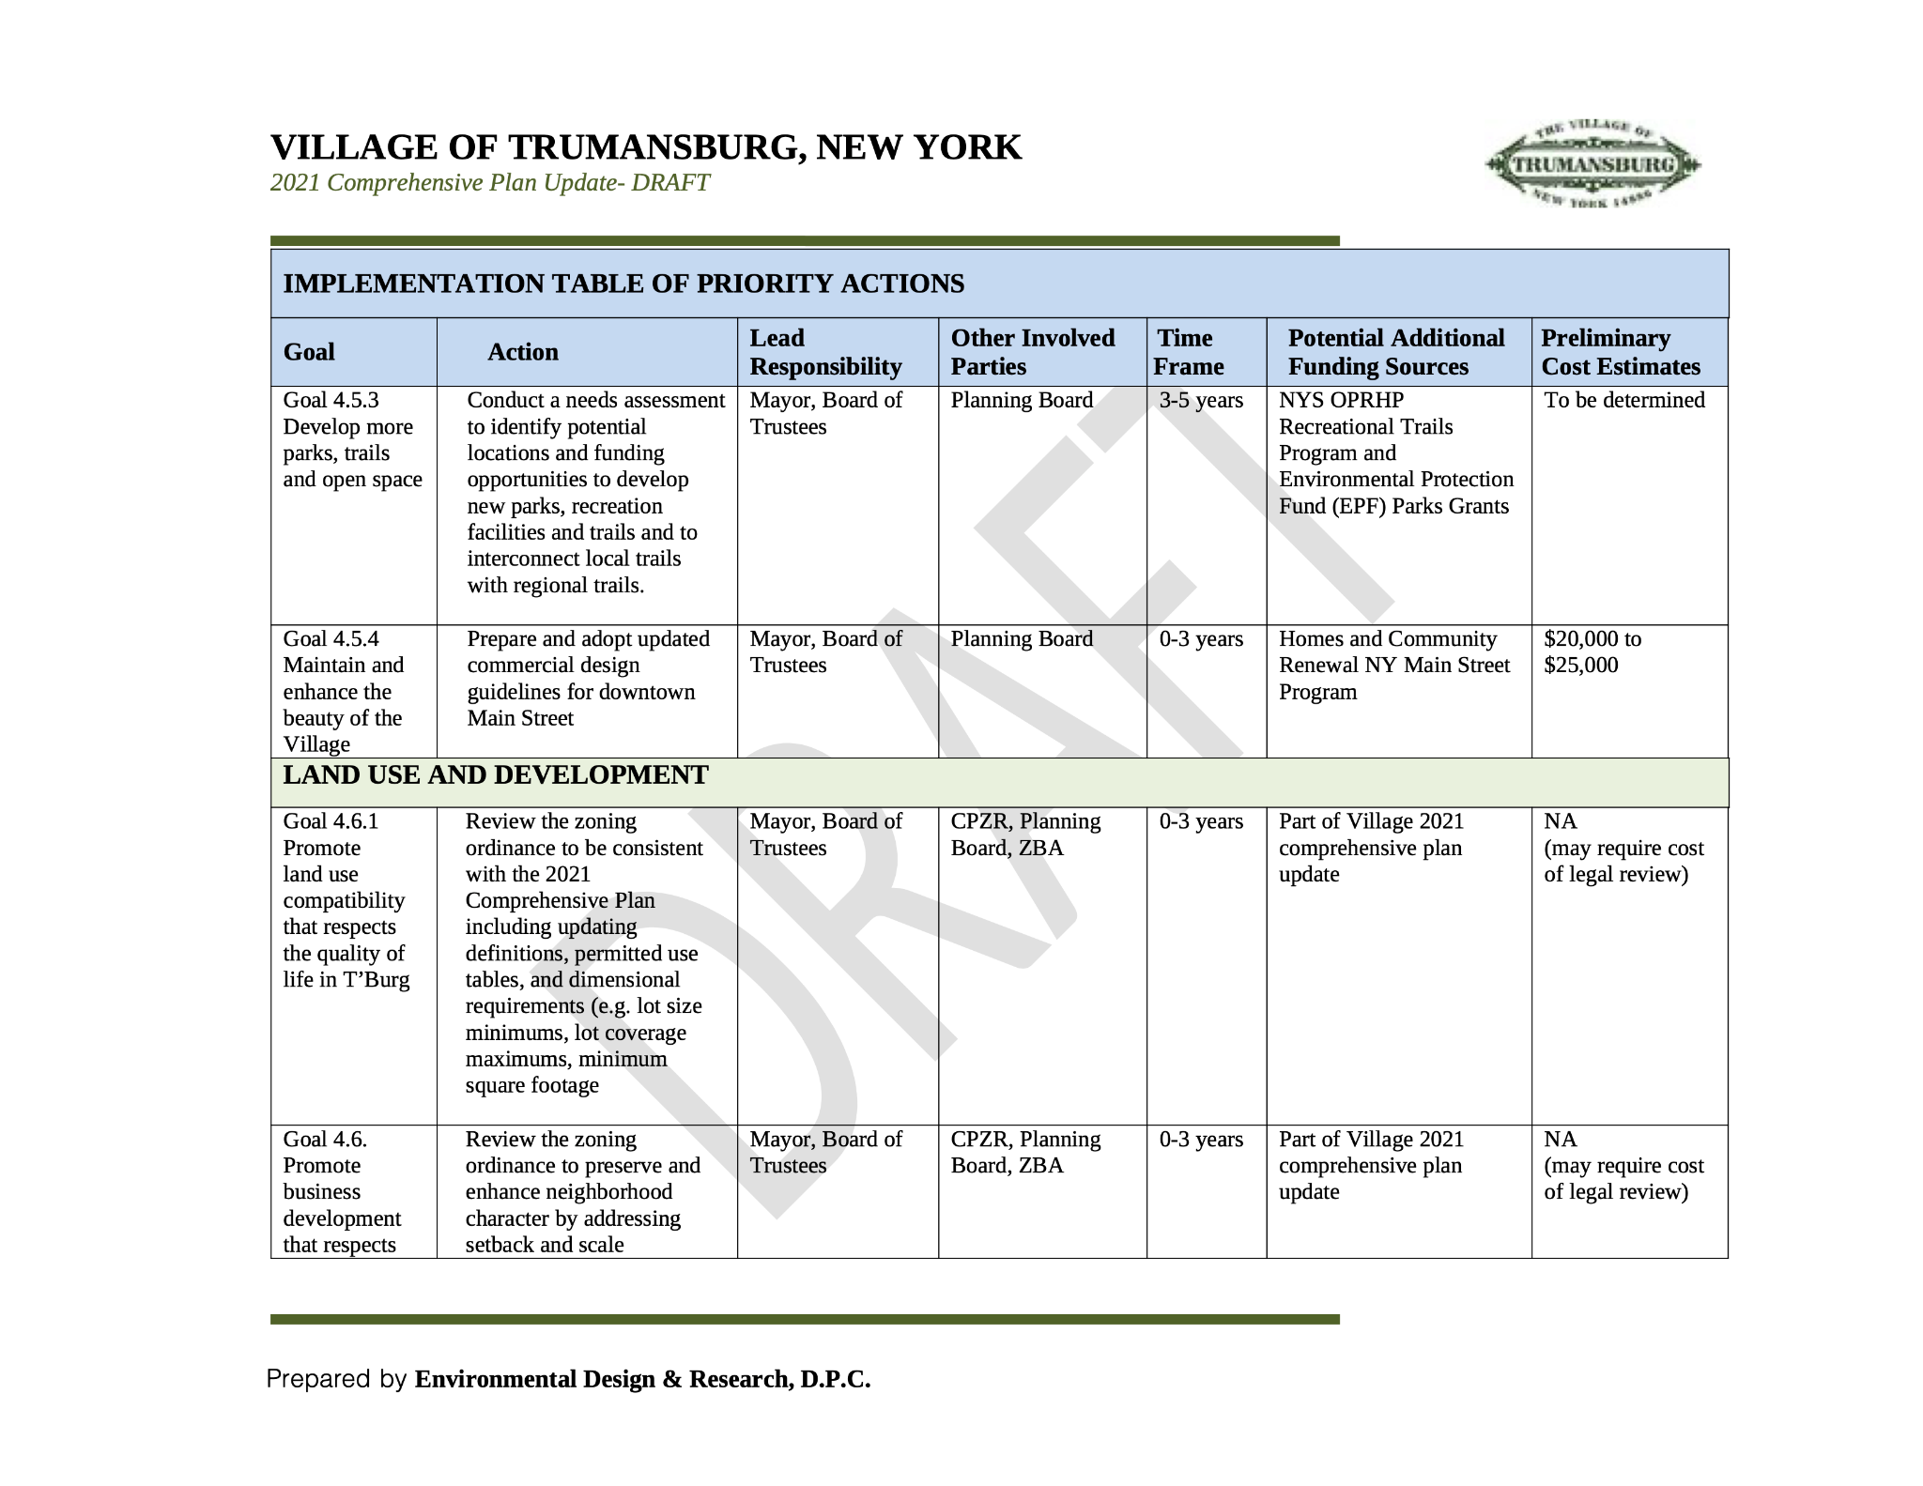

Slide 27
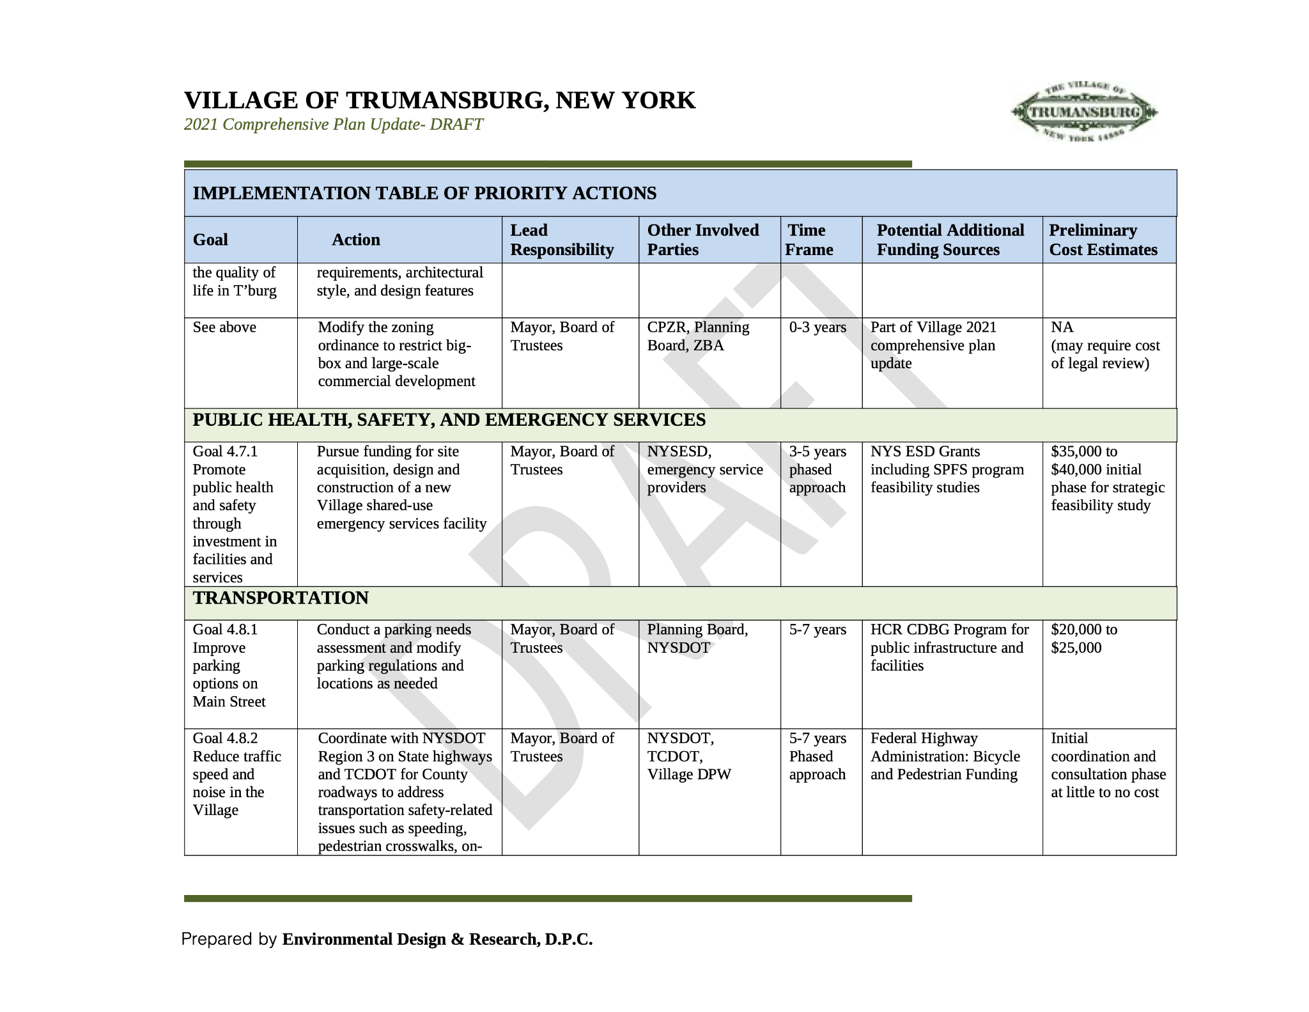

Slide 28
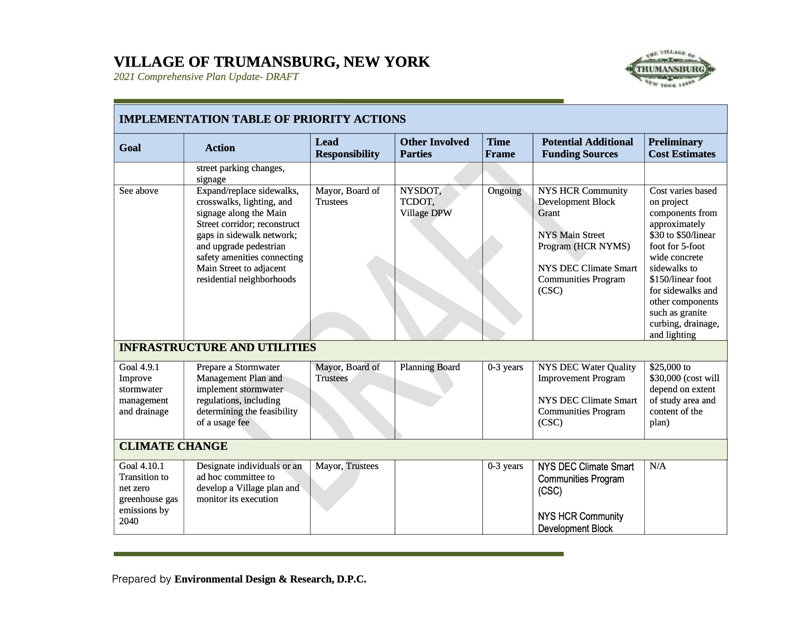

Slide 29
